Slide 1
Strings
When you want to store a text-based value in a Java program you need to use the String type.
Strings in java are a reference type (ie. each String is an object) and thus you would normally need to create a String using the “new” keyword:
String day = new String("Monday");
(more on this keyword later in week 3)
However as Strings are so commonly used in programs there is an equivalent short-cut syntax for defining and initialising a String in Java:
String day = "Monday";
If you change the “value” of a String then you are replacing the String object you had initially with a new one (containing the new text that was specified):
day = "Friday"; // replaces “Monday" with a new String "Friday"
Once a String object is created it cannot be changed in any way (ie. it is an immutable object) - the only thing you can do is replace the String entirely with a new String!

Slide 2
Strings
How are Strings stored in program memory?
Each String is accessible via a reference, which stores the location of that String object in memory.
A diagram showing how the Strings from the previous example will be stored is shown to the right.
String day = new String(“Monday");
String day = “Monday";
day = “Friday";
Note that the String “Monday” is lost once it has been replaces with the String “Friday”.
name
@1000
String
“Monday"
1000
name
@1000
String
“Monday"
2000
String
“Friday"
@2000

Slide 3
String Operations
String myName = "George";
the snapshot of memory is
0 1 2 3 4 5
G
e
o
r
g
e
Note that the first index is 0, not 1. Once a String object is created we can use its methods, such as
myName.charAt(2); // returns 'o'
myName.indexOf('e'); // returns 1, it is the first 'e’
myName.indexOf("or");// returns 2 as "or" starts at 2
If mutable strings are required java.lang.StringBuffer or java.lang.StringBuilder class should be used e.g:
StringBuffer nameBuffer = new StringBuffer("Cherles");
nameBuffer.setCharAt(2,'a'); // "Cherles" -> Charles
String name=nameBuffer.toString();
Most useful for building strings in loops!

Slide 4
Example using the length() and charAt() methods
import java.util.*;
public class TestString
{ public static void main(String args[])
{ String s;
Scanner console = new Scanner(System.in);
System.out.print("Enter a String : ");
s = console.nextLine();
int len = s.length();
System.out.println("Length of s1 is " + len);
System.out.print("Enter character index: ");
int index = console.nextInt();
System.out.println("char at index "+ index + " is " +
s.charAt(index));
}
}
(a) What will be the output if input String is Elephant and index is 1 ?
(b) input String is Cat and index is 3 ?
(i) What is the name of Exception thrown (if any) ? __________________
(ii) Why was it thrown? _________________________________________

Slide 5
String operations
String concatenation
The concat() method or the operator ‘+’ may be used to concatenate two strings together in a simple manner:
String s1 = "One";
String s2 = "Two";
String s3 = s1.concat(s2); // new String with text "OneTwo";
String s4 = s1 + s2; // new String with text "OneTwo";
The operator + can be also used to concatenate a string with a number, a char or even a Boolean if needs be.. Note that each of the above operations creates a new string.
It is generally preferable to use String.format() for more complex String formatting since it is more efficient and flexible (more on this later).

Slide 6
Substrings
The substring() method creates a substring. It has two forms:
public String substring(int startIndex, int endIndex)
public String substring(int startIndex)
The first one returns a new string formed by characters from startIndex to endIndex-1.
The second one returns a new string formed by characters from startIndex to the end of string.

Slide 7
String Conversions
Recall contents of an existing String object cannot be changed as it is immutable.
However it provides a number of useful methods that creates a new string based on existing one.
toLowerCase() – returns a string with all lowercase
toUpperCase() – returns a string with all uppercase
replace(char c1, char c2) – returns a String with all occurrences of char c1 replaced with c2.
replaceAll(String s1, String s2) – returns a String with all occurrences of substring s1 replaced with s2.
Notes:
Explain parameters or arguments, return, etc.

Slide 8
3 Predefined Objects for Input/Output
System.out
PrintStream
Input a line
Error in Input
System.err
PrintStream
System.out.println("Input a line");
System.err.println("Error in Input");
InputStream
System.in
String message = System.in.nextLine(); ?
No Such method !

Slide 9
Using a Scanner to read basic text input
write a program to:
read a string from user
a prompt should be used
echo it on screen.
Input a line of text:
my name is Joe Bloggs
Your input was: my name is Joe Bloggs

Slide 10
// need to import the Scanner class in order to use a Scanner
import java.util.Scanner;
public class Echo1
{
public static void main (String[] args)
{
// create a Scanner that is connected to System.in
Scanner console = new Scanner(System.in);
// prompt user to enter value
System.out.print("Input a line of text: ");
// use Scanner to read user’s input and store it
// in a variable for later reference
String message = console.nextLine();
// display the user’s input (message_ to the screen
System.out.println("Your input was: " + message);
}
}

Slide 11
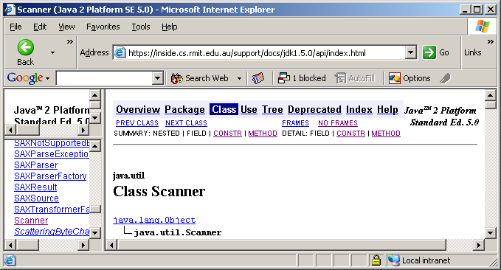
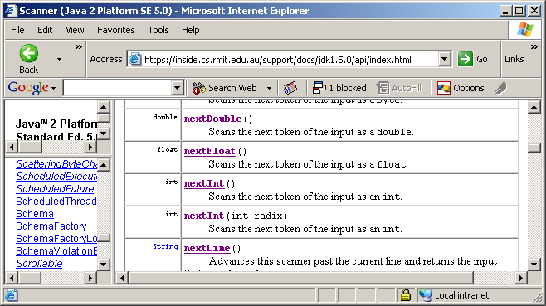
Checking out the Scanner class
In the package java.util
Refer to the Scanner in Java Docs
Methods of interest that read and return the next int, double and return

Slide 12
Using the Scanner class
Import the package
import java.util.*;
public class Echo {
public static void main (String[] args) {
Scanner console = new Scanner(System.in);
System.out.println("Input a line of text");
String message = console.nextLine();
System.out.println("Your input was: "
+ message);
}
}
Call the nextLine() method on the Scanner object to read and return a string
Similarly call nextInt() and nextDouble() to read and return int and double values.
To constructor a Scanner object pass the predefined reference System.in

Slide 13

Output using print()
import java.util.Scanner;
public class SumDemo2 {
public static void main (String[] args) {
Scanner keyboard = new Scanner(System.in);
System.out.print("Enter value for n1 : ");
double n1 = keyboard.nextDouble();
System.out.print("Enter value for n2 : ");
double n2 = keyboard.nextDouble();
double sum = n1 + n2;
System.out.print("Sum of "+n1+ " and " + n2 +
" is " + sum);
}
}
Unlike print(), printf() allows setting width & decimal places directly.

Slide 14
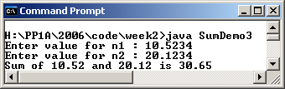
Formatted output using printf()
import java.util.Scanner;
public class SumDemo3 {
public static void main (String[] args)
{
Scanner keyboard = new Scanner(System.in);
System.out.print("Enter value for n1 : ");
double n1 = keyboard.nextDouble();
System.out.print("Enter value for n2 : ");
double n2 = keyboard.nextDouble();
double sum = n1 + n2;
System.out.printf("Sum of %.2f and %.2f is %.2f",
n1, n2, sum);
}
}
2
2
2

Slide 15
Commonly used printf()/String.format conversion symbols
General Syntax
%[argument_index$][flags][width][.precision]conversion
Sample conversions
%c a character
%d a decimal integer
%f a floating point number
%s a string
%b a boolean value
See https://docs.oracle.com/javase/8/docs/api/java/util/Formatter.html#syntax
* See also java.lang.String.format() method

Slide 16
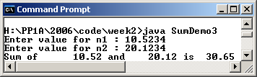
Using width and precision modifiers in printf()
In the previous program changing last statement to
System.out.printf("Sum of %10.2f and %8.2f is %6.2f",
n1, n2, sum);
produces the following results:
10
8
6

Slide 17
Tabulating output using printf()
You can also align values in a tabular manner using field width modifiers in printf().
Example 1: print labels and values in fixed-width "columns"
int valueA = 1, valueB = 3, valueC = 5;
System.out.printf("%-20s %d\n", "First value is:", valueA);
System.out.printf("%-20s %d\n", "Second value is:", valueB);
System.out.printf("%-20s %d\n", "Third value is:", valueC);
Output from the program
First value is: 1
Second value is: 3
Third value is: 5
20

Slide 18
Example 2: print series of values in a "table"
System.out.printf("%-8s %-8s %-8s %-8s\n",
"Value", "x2", "x3", "x4");
System.out.println("-------------------------------");
System.out.printf("%-8d %-8d %-8d %-8d\n",
valueA, valueA * 2, valueA * 3, valueA * 4);
System.out.printf("%-8d %-8d %-8d %-8d\n",
valueB, valueB * 2, valueB * 3, valueB * 4);
System.out.printf("%-8d %-8d %-8d %-8d\n",
valueC, valueC * 2, valueC * 3, valueC * 4);
Output from the program
Value x2 x3 x4
-------------------------------
1 2 3 4
3 6 9 12
5 10 15 20

Slide 19
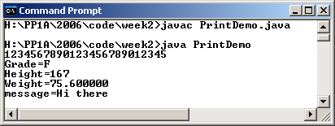
Printing different variable types
You can print other variable types in printf as well:
public class PrintDemo {
public static void main (String[] args) {
int ht = 167;
String message = "Hi there";
double wt = 75.60;
char grade = 'F';
System.out.println(
"1234567890123456789012345");
System.out.printf("Grade=%c\n",grade);
System.out.printf("Height=%d\n",ht);
System.out.printf("Weight=%f\n",wt);
System.out.printf("message=%s\n",message);
}
}

Slide 20
Write a program to add two numbers
where are the numbers coming from?
are they whole numbers ? decimal part allowed ?
where should the output go to?
Input the first integer number:
5
Input the second integer number:
7
The sum is: 12

Slide 21
Sample Program
import java.util.*;
public class SumDemo
{
public static void main (String[] args)
{
Scanner console = new Scanner(System.in);
int num1, num2, sum;
System.out.println("Input an integer number");
num1 = console.nextInt();
System.out.println(
"Input another integer number");
num2 = console.nextInt();
sum = num1 + num2;
System.out.println("The sum is: " + sum);
}
}
Notes:
Contrast with slide 65

